Slide 1

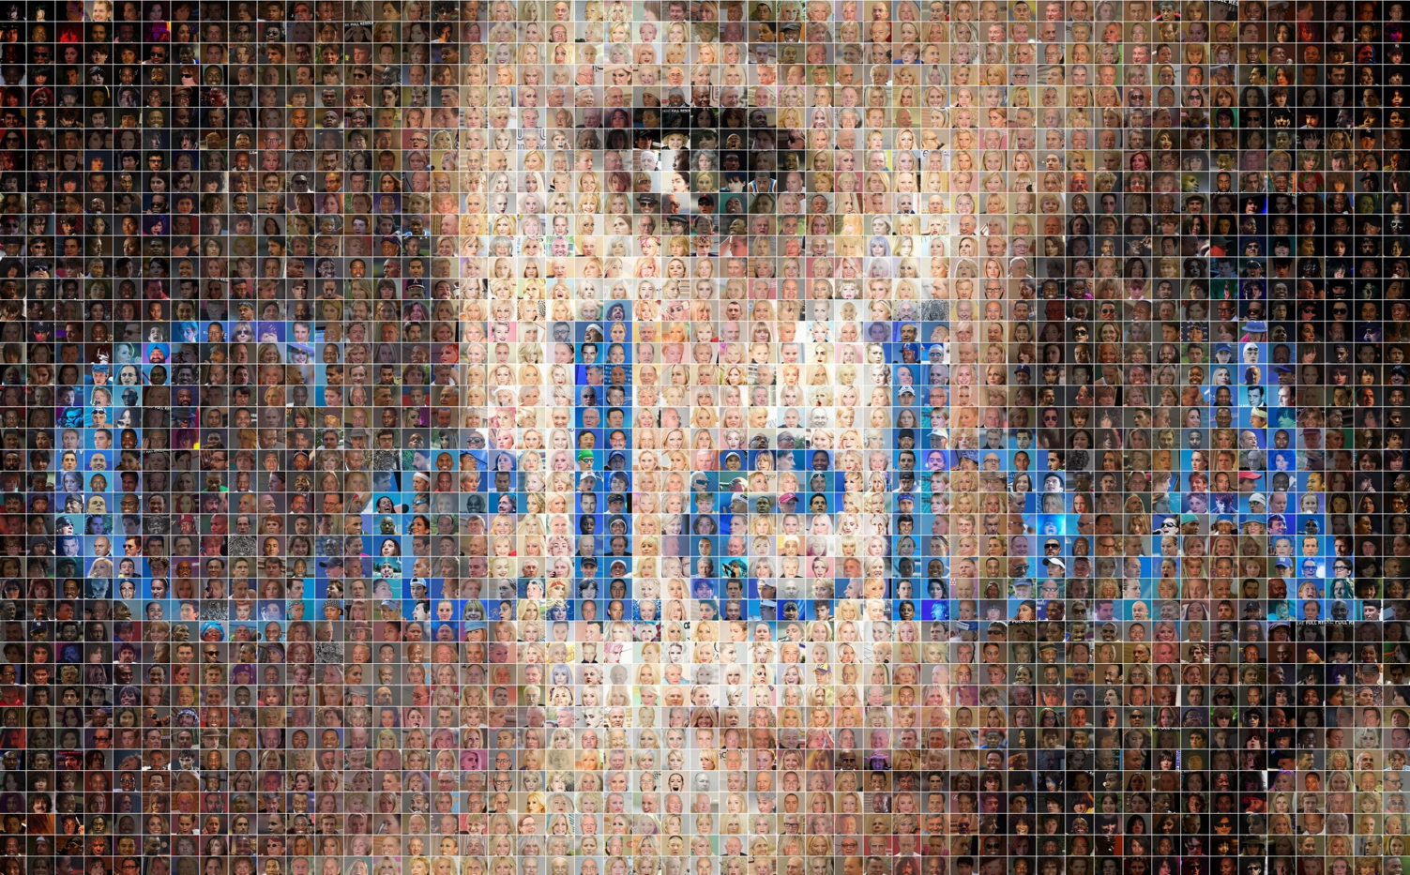
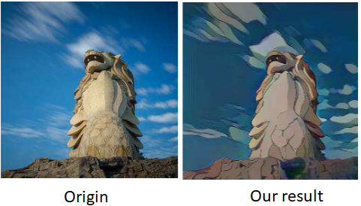
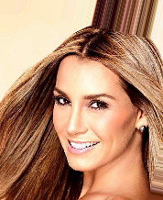
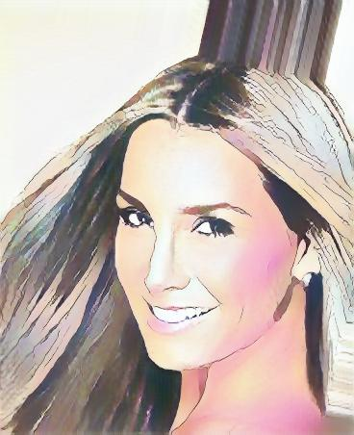
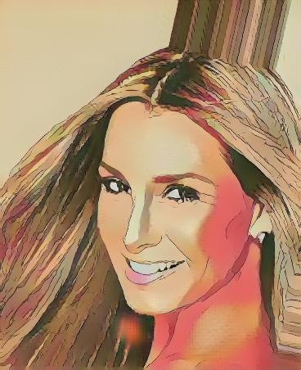
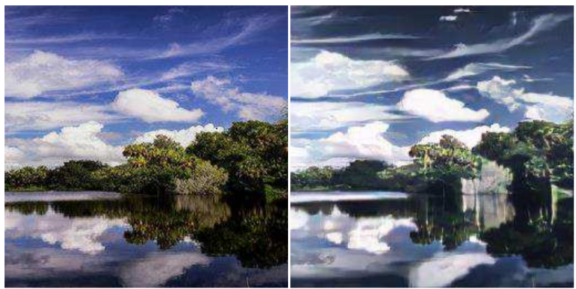
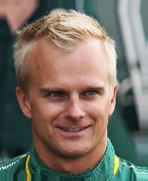
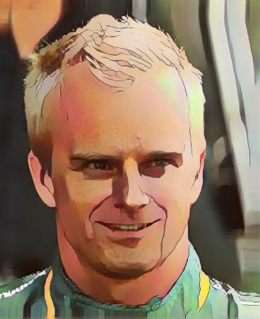
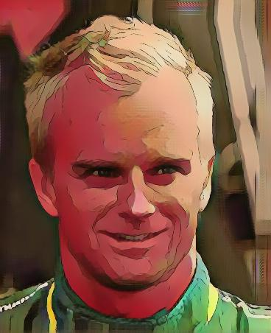
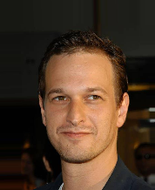
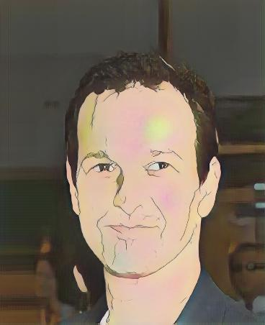
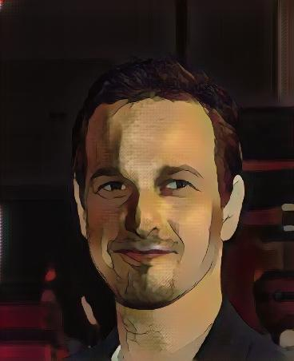
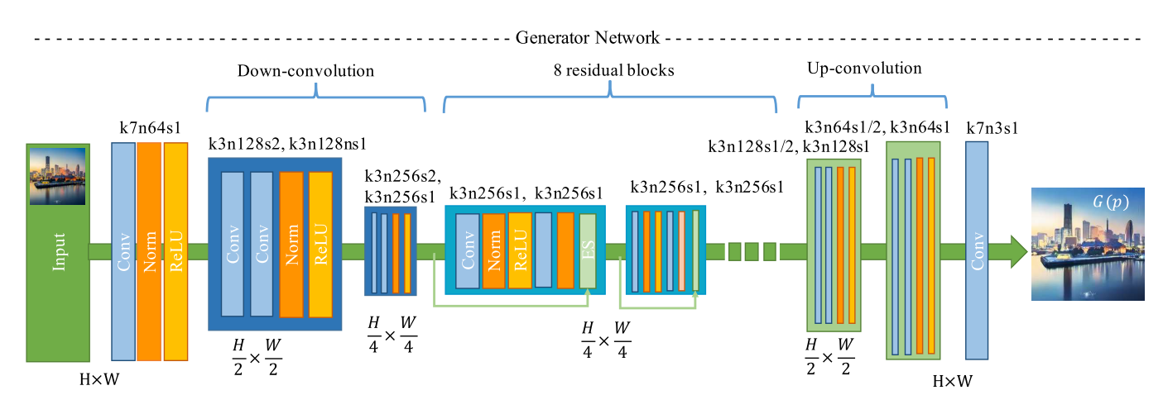
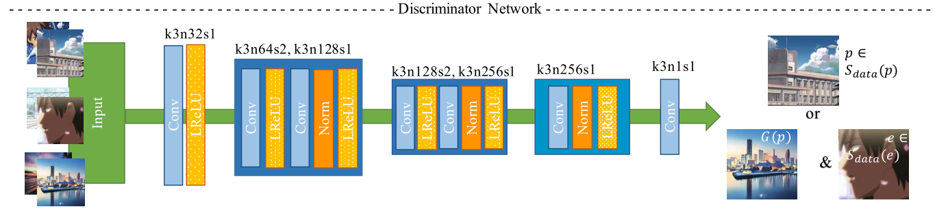

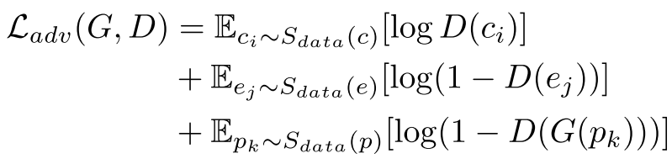
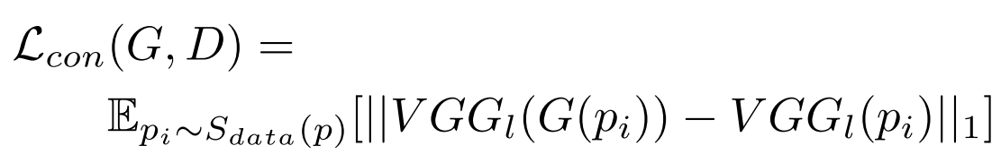
CartoonGAN: Generative Adversarial Networks for
Photo Cartoonization
Po-Yuan Lin
National Tsinghua University
Taiwan
Chien-Li Lu
National Chiao Tung University
Taiwan
Introduction
Result on human face
CartoonGAN propose a solution to transforming photos of real-
world scenes into cartoon style images, which is valuable and challenging in computer vision and computer graphics.
Cartoons are an artistic form widely used in our daily life
In addition to artistic interests, their applications range from
publication in printed media to storytelling for children’s education. Like other forms of artworks, many famous cartoon images were created based on real-world scenes.
Origin
Transfer to cartoon style
Our dataset
Origin 細田守 宮崎駿
Network architecture
Conclusion
The original paper focused on transfer non-face photo to cartoon style image, so we planned to implement the image about human face shown above.We can see that it’s good at transferring image except face features of eyes and other part that had high-fineness
reference
CartoonGAN: http://openaccess.thecvf.com/content_cvpr_2018/papers/Chen_CartoonGAN_Generative_Adversarial_CVPR_2018_paper.pdf
Loss function
Cartoon image data
Cartoon image data with edges smoothed out
Generated image form G
Adversarial loss:
To drives the generator network to achieve the desired manifold transformation.
content loss:
To preserves the image content during cartoon stylization
In CartoonGAN, We adopt the high-level feature maps in the VGG networks

